Slide 1
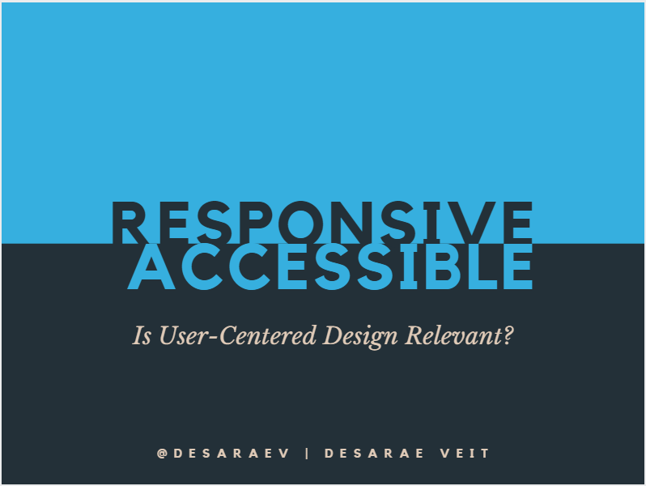
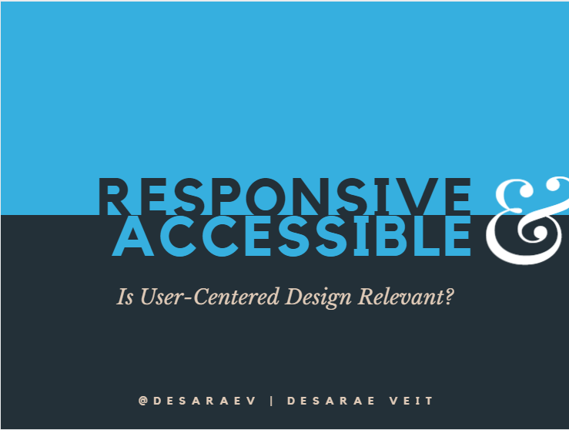

Responsive Design & Accessibility Is it relevant to application development?
Desarae Veit
Notes:
Header font: Kollektif 75.7Blue: 36afdf Bold uppercase center
Secondary font: Libre Baskerville 28 italic center
Third font: Kollektif 14 e0cbb8 Bold uppercase center

Slide 2
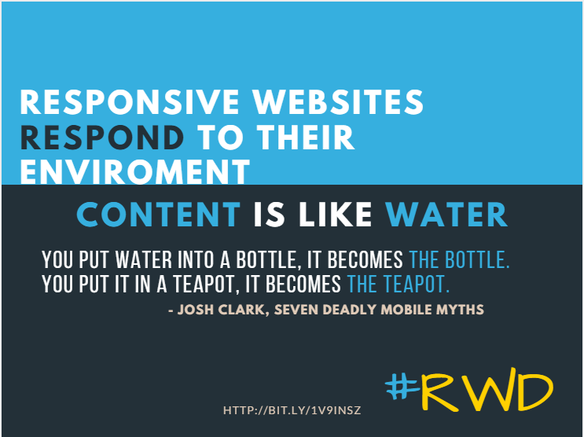
Notes:
Responsive design is everywhere, it allows end users with varying screen widths to view the same content without fixed-width restrictions. This makes sites visually and functionally more accessible via mobile devices, tablets, and smaller browsers.

Slide 3
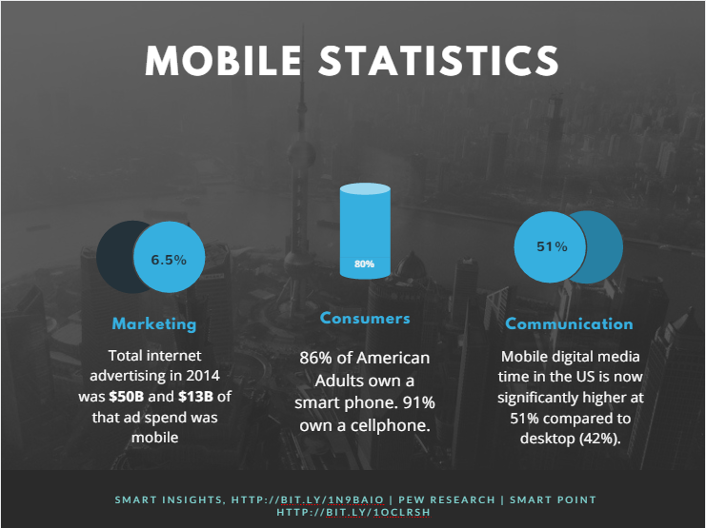

Slide 4
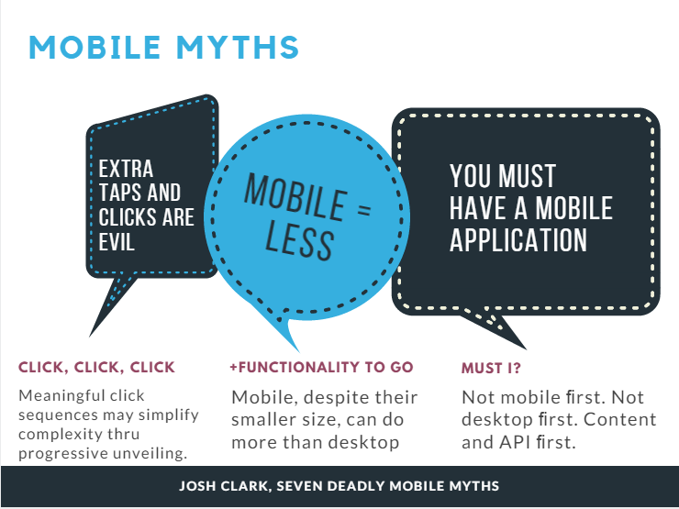

Slide 5
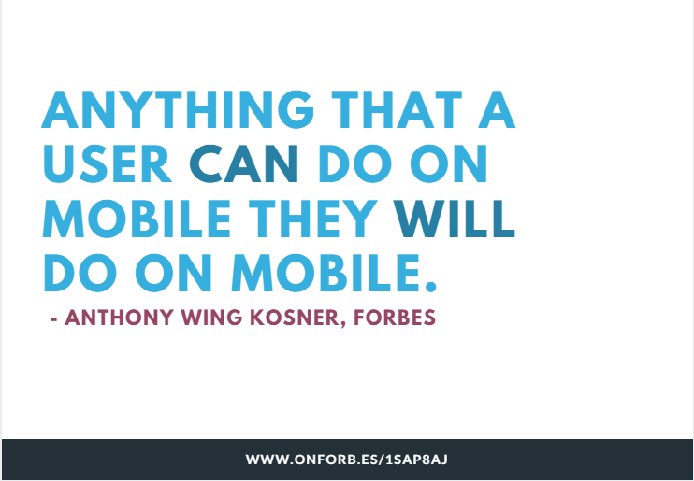

Slide 6


Slide 7


Slide 8
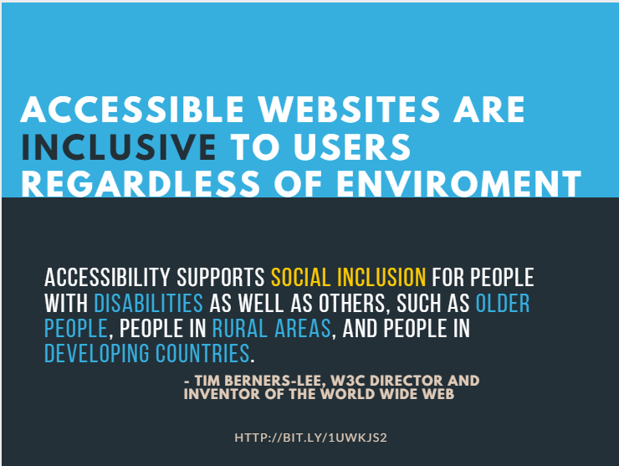
Notes:
Individuals with disabilities are people who have sensory, physical, or cognitive impairments that substantially limit their ability to perform one or more major life activities. The degree of disability may range from mild to moderate to severe or profound. A person may also have multiple disabilities, or they may have “hidden” disabilities and show no outward sign that a disabling condition exists. If you do not have a disability, you probably know someone—in your family, circle of friends and acquaintances, or a co-worker—who does. Some people are born with a disability. Others may have experienced some event, such as a sports injury, repetitive stress injury, or onset of health condition that resulted in their disability.
Information and data must be available in a way that meets federal standards that enable persons with disabilities to access it. The law requires Federal employees and members of the public with disabilities to have access to and use of information and data that is comparable to other Federal employees and individuals without disabilities. Conformance with these standards is mandated by Section 508 of the Rehabilitation Act of 1973, as amended (Section 508). Whether you are creating documents, designing presentations, buying products, or supporting EIT, it is important for you to understand your Section 508 responsibilities. Section 508 was enacted to eliminate barriers in EIT, make opportunities available for persons with disabilities, and encourage development of technologies that will help achieve these goals.-- DOI

Slide 9
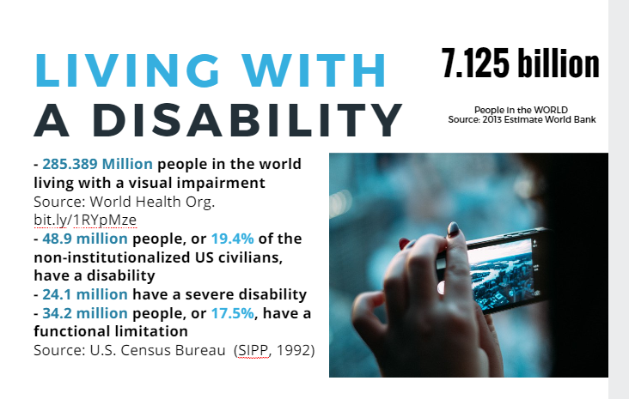

Slide 10
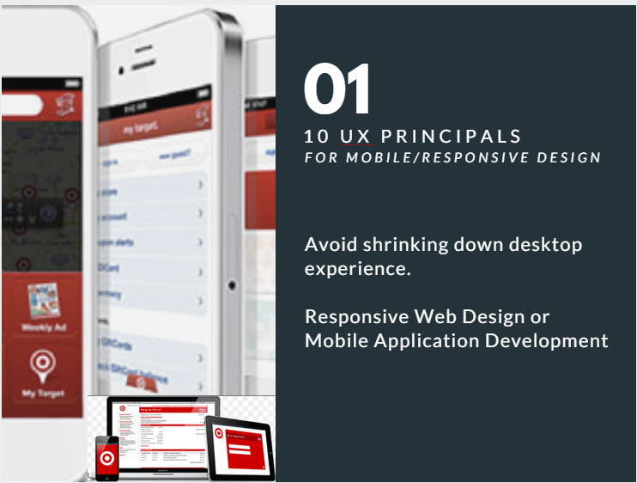

Slide 11


Slide 12
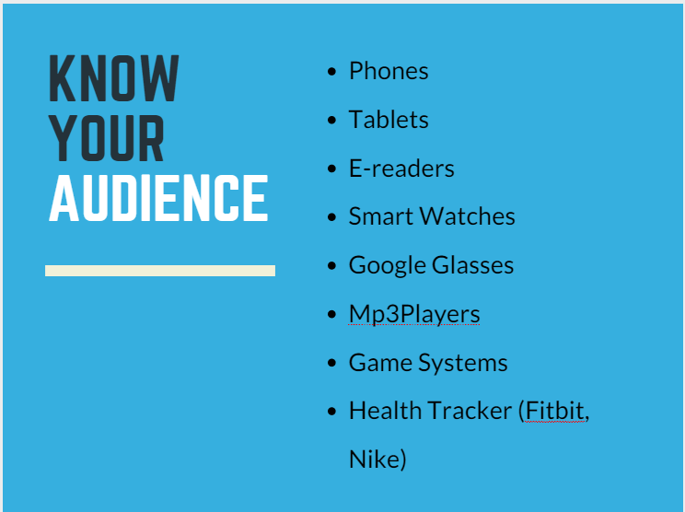

Slide 13
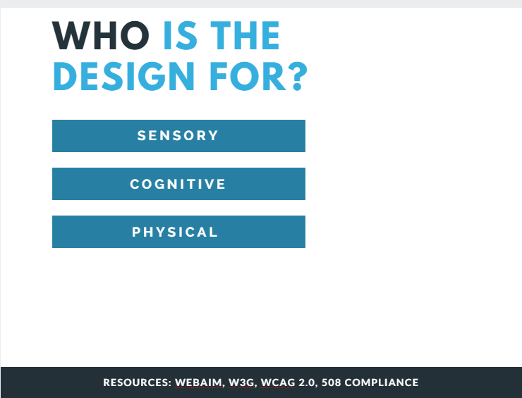

Slide 14


Slide 15
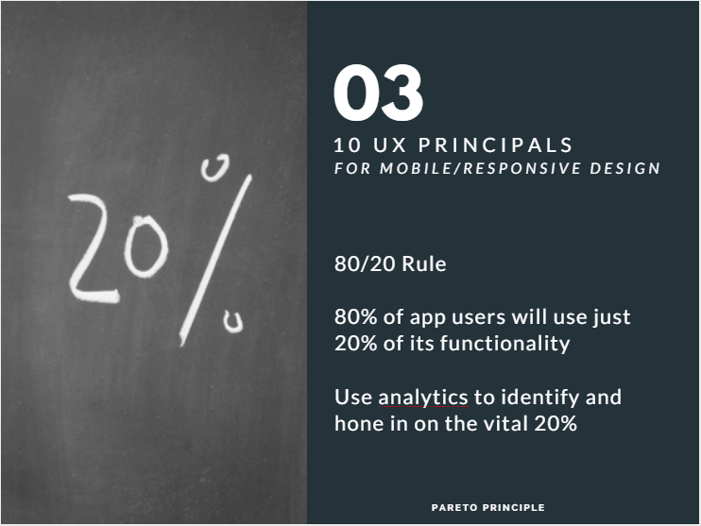

Slide 16


Slide 17
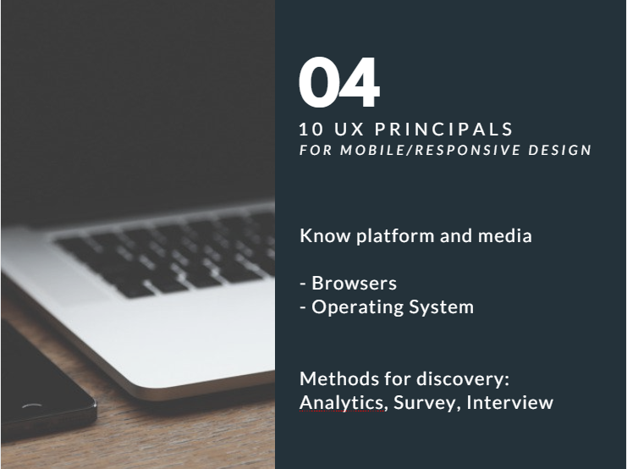

Slide 18
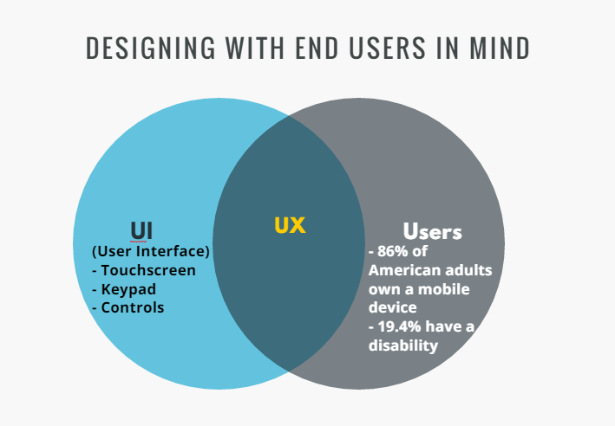
Notes:
Responsive design also makes it possible to single-source your code, making it unnecessary to have a mobile version and a desktop version of a site, therefore reducing production and maintenance costs.
In addition, it turns a desktop application into a mobile app that is written in native HTML, making app development for IOS and Android also unnecessary (unless the business model is to sell it in the respective app stores).
Originally development teams would develop different version of their applications so they would render correctly on the different clients. This was costly, required longer development cycles, etc…
Today developers are Turing to Responsive design. Responsive design is a newer design paradigm that allows application development teams to develop one application that will sell adjust to screen size……

Slide 19
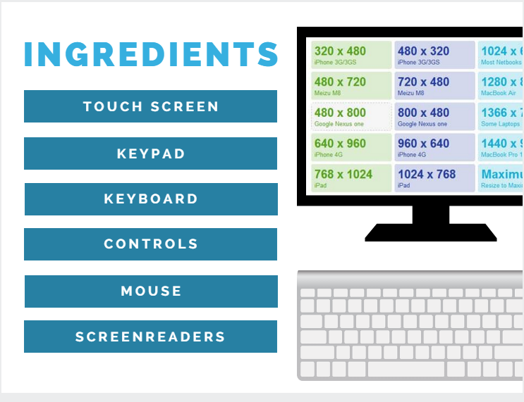
Notes:
We all rely on electronic devices every day for a variety of different reason. Many of our devices come in different sizes and shapes requiring application development teams to rethink how they design their applications so that they display correctly on these many varying devices.

Slide 20
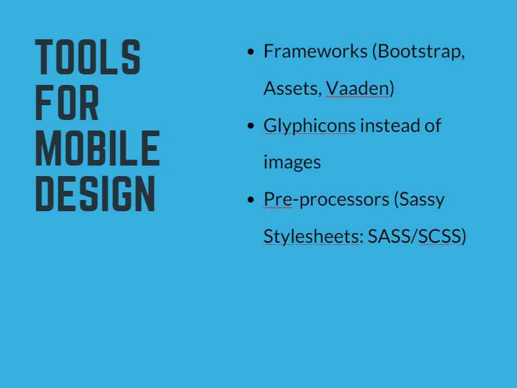

Slide 21
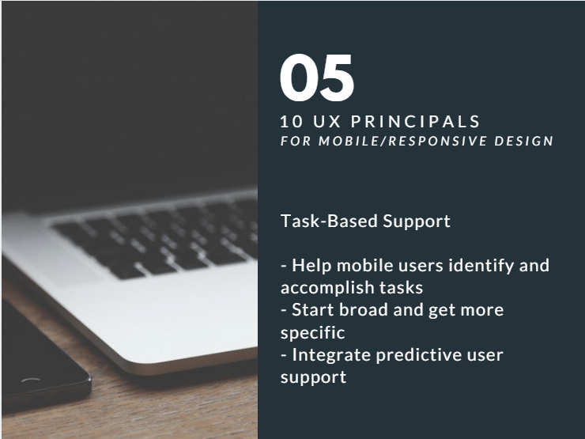

Slide 22
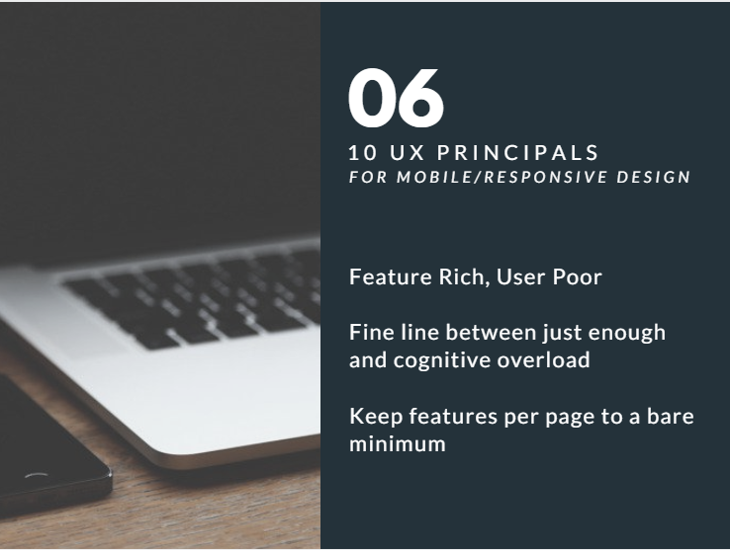

Slide 23
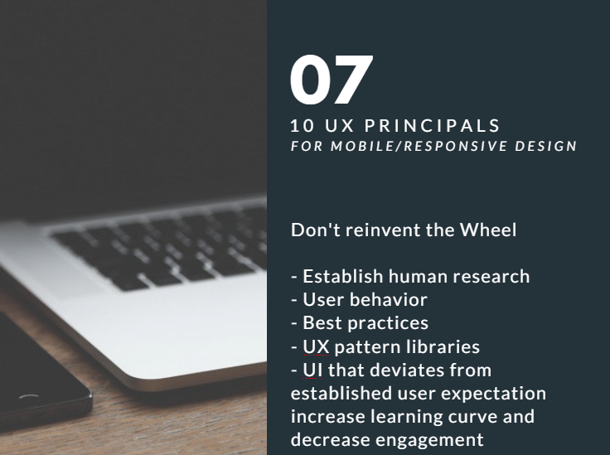

Slide 24
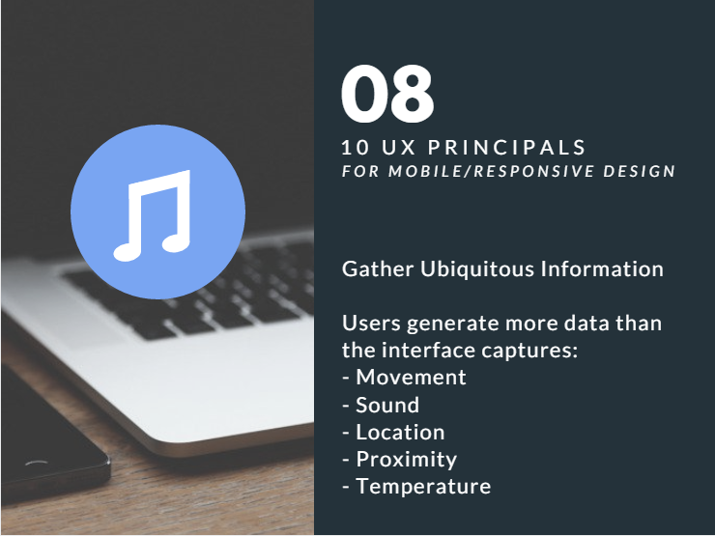

Slide 25
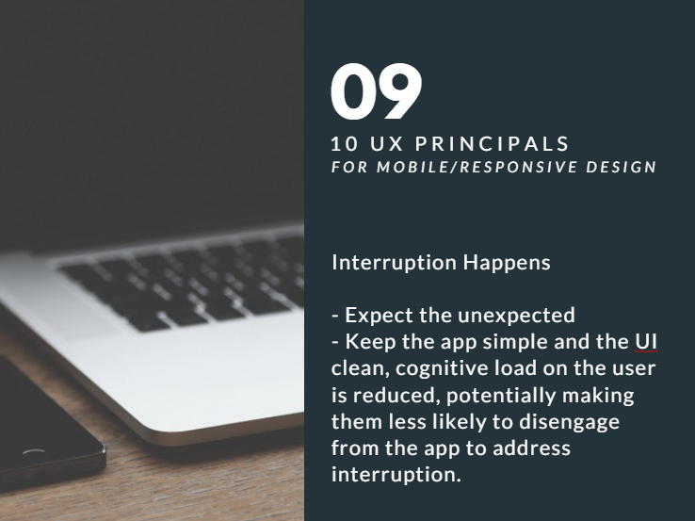

Slide 26
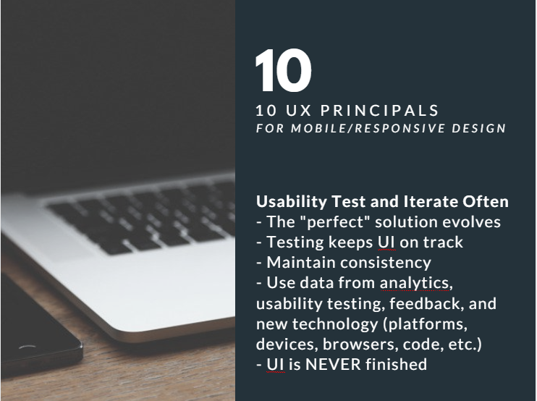

Slide 27


